Slide 1

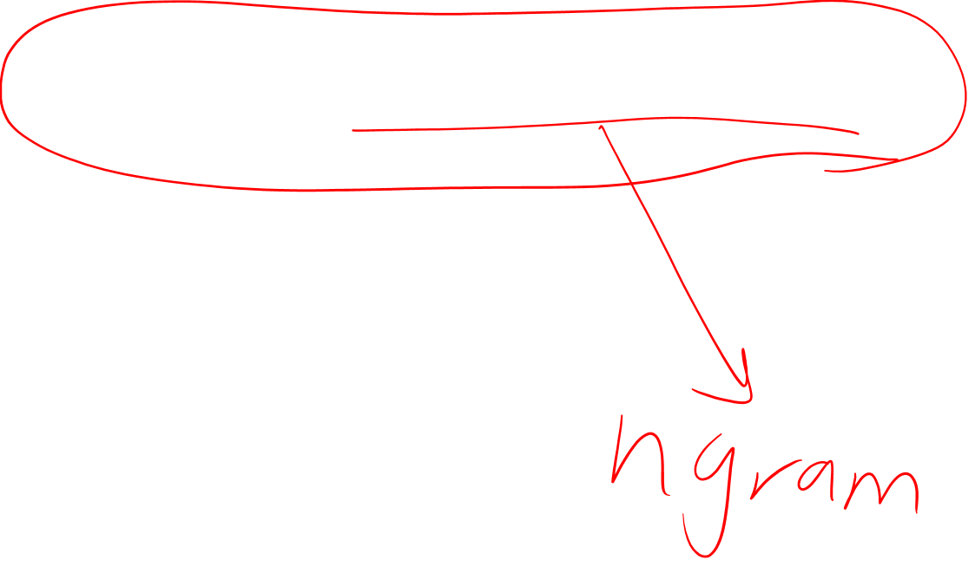
Chapter 7: Neural Networks and Neural Language Models
Heshaam Faili
hfaili@ut.ac.ir
University of Tehran

Slide 2
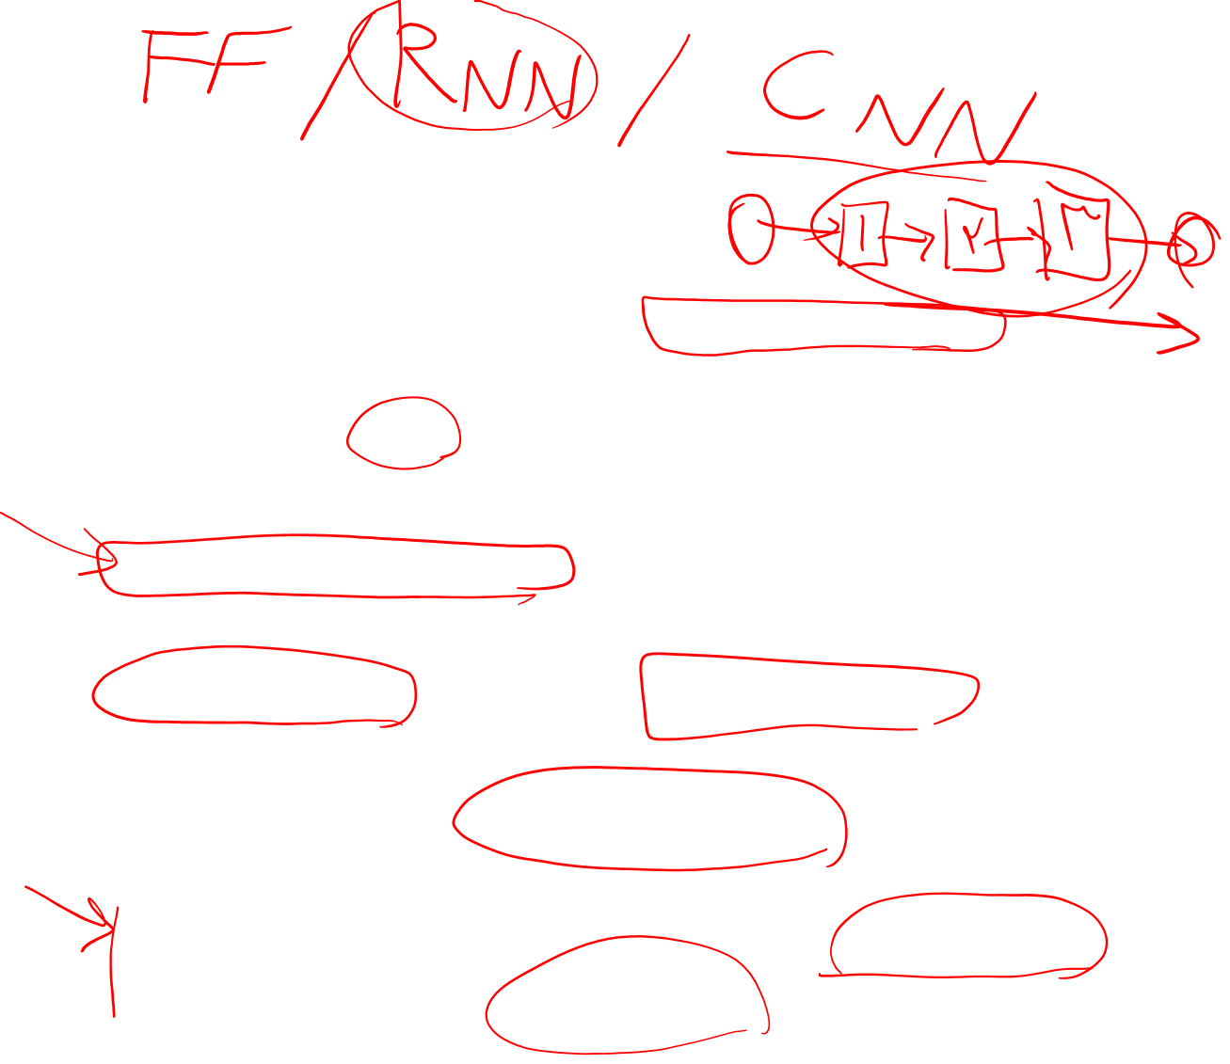
Neural Network
a simplified model of the human neuron
modern neural network is a network of small computing units, each of which takes a vector of input values and produces a single output value
feed-forward network:computation proceeds iteratively from one layer of units to the next
deep learning:have many hidden layers
share some of the same mathematics and learning architectures as logistic regression but more powerful classifier
indeed a neural network with one hidden layer can be shown to learn any function.

Slide 3
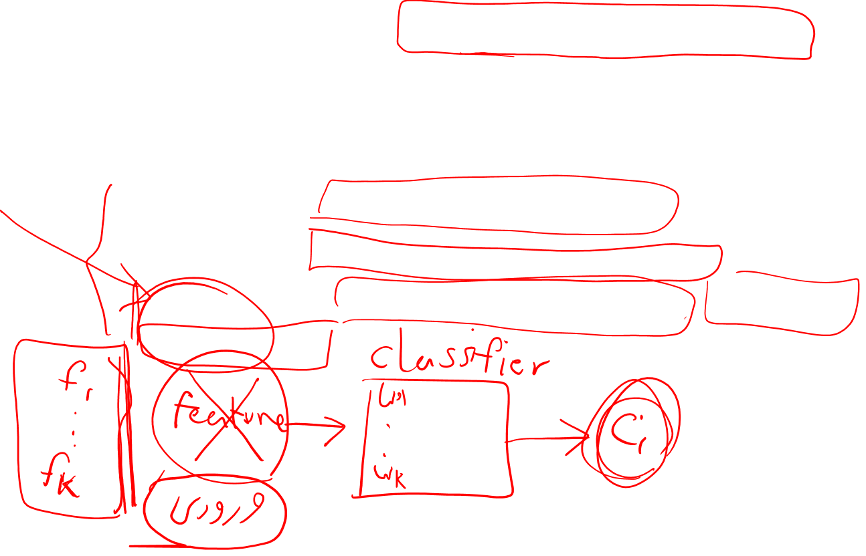
Neural Network
avoid the use of rich hand-derived features, instead building neural networks that take raw words as inputs and learn to induce features as part of the process of learning to classify
Chapter 7: Feed forward Network
Chapter 9: Recurrent Neural Network
Chapter 10: encoder-decoder model, attention, transformer

Slide 4
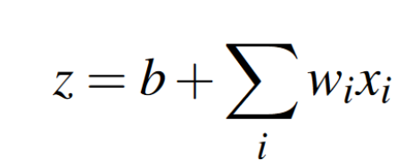
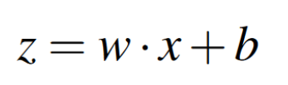
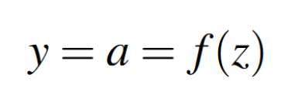
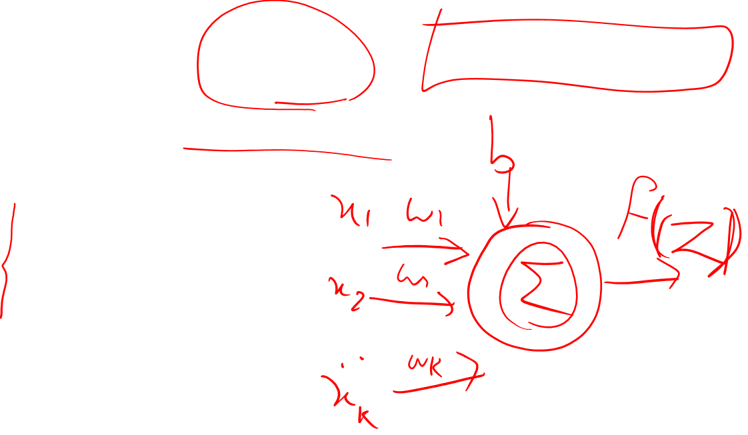
Units
The building block of a neural network is a single computational unit
Activation: non-linear function on z
Activation functions:
Sigmoid
Tanh
rectified linear ReLU

Slide 5
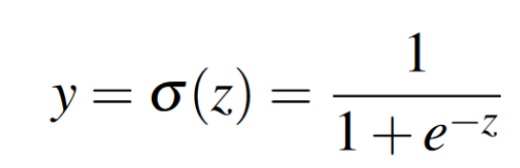
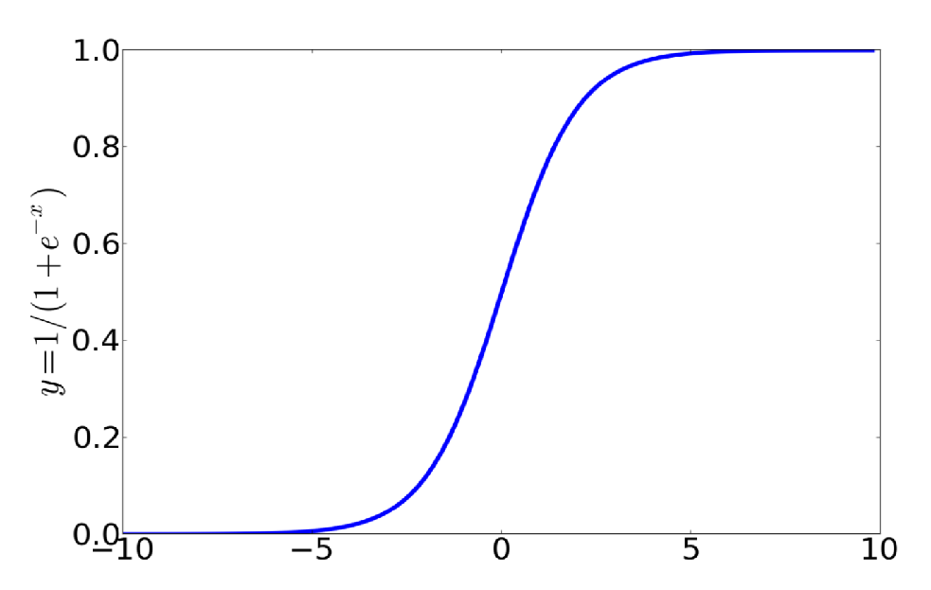
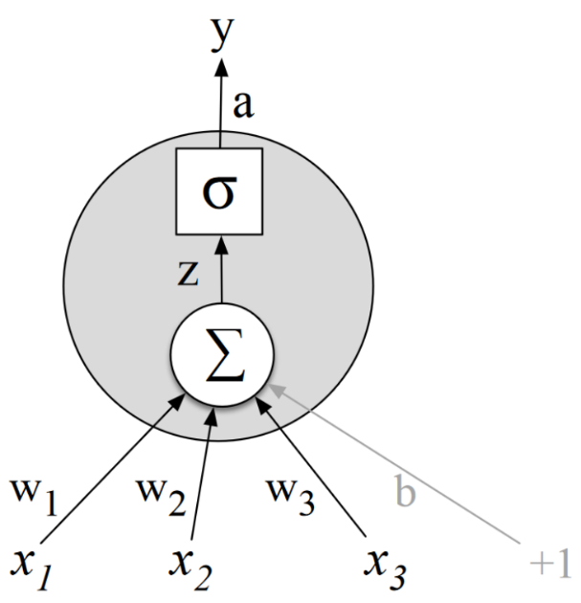
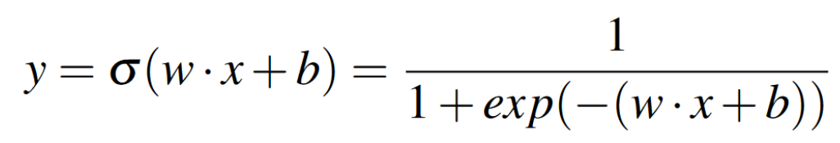
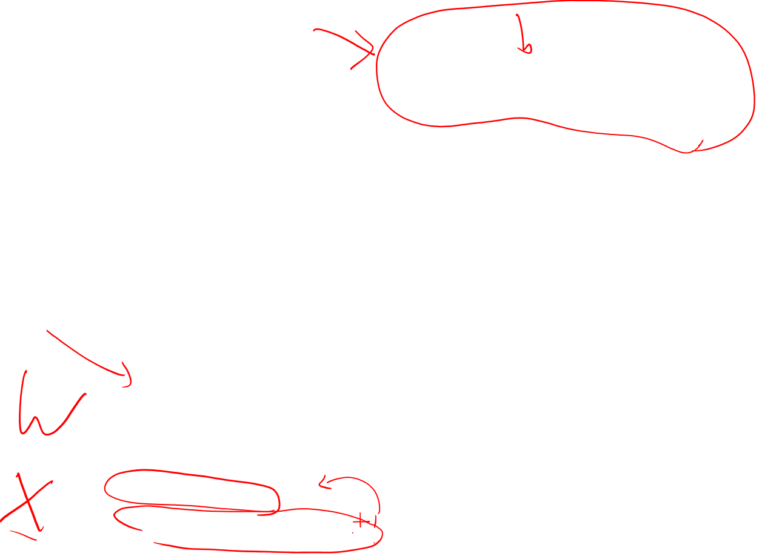
Sigmoid
it maps the output into the range [0,1]
Differentiable: useful for learning

Slide 6
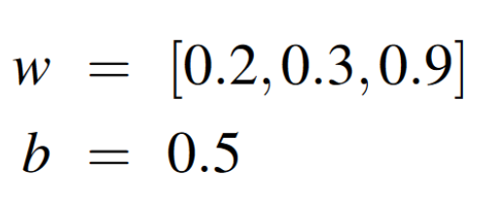
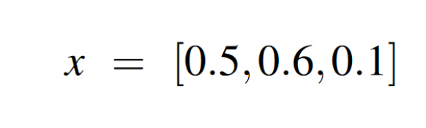
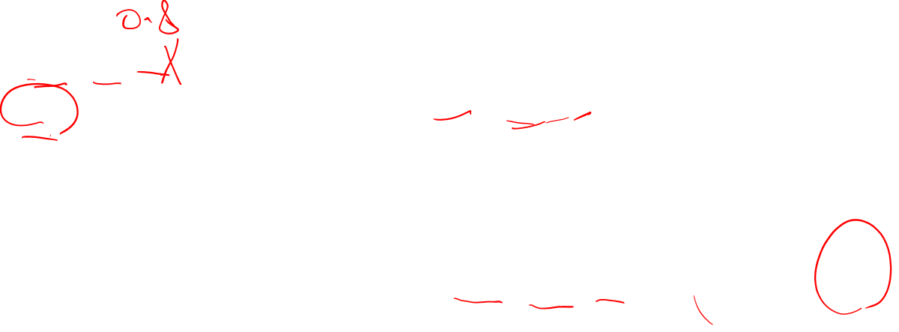
example

Slide 7
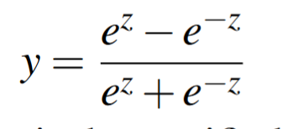
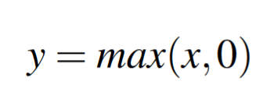
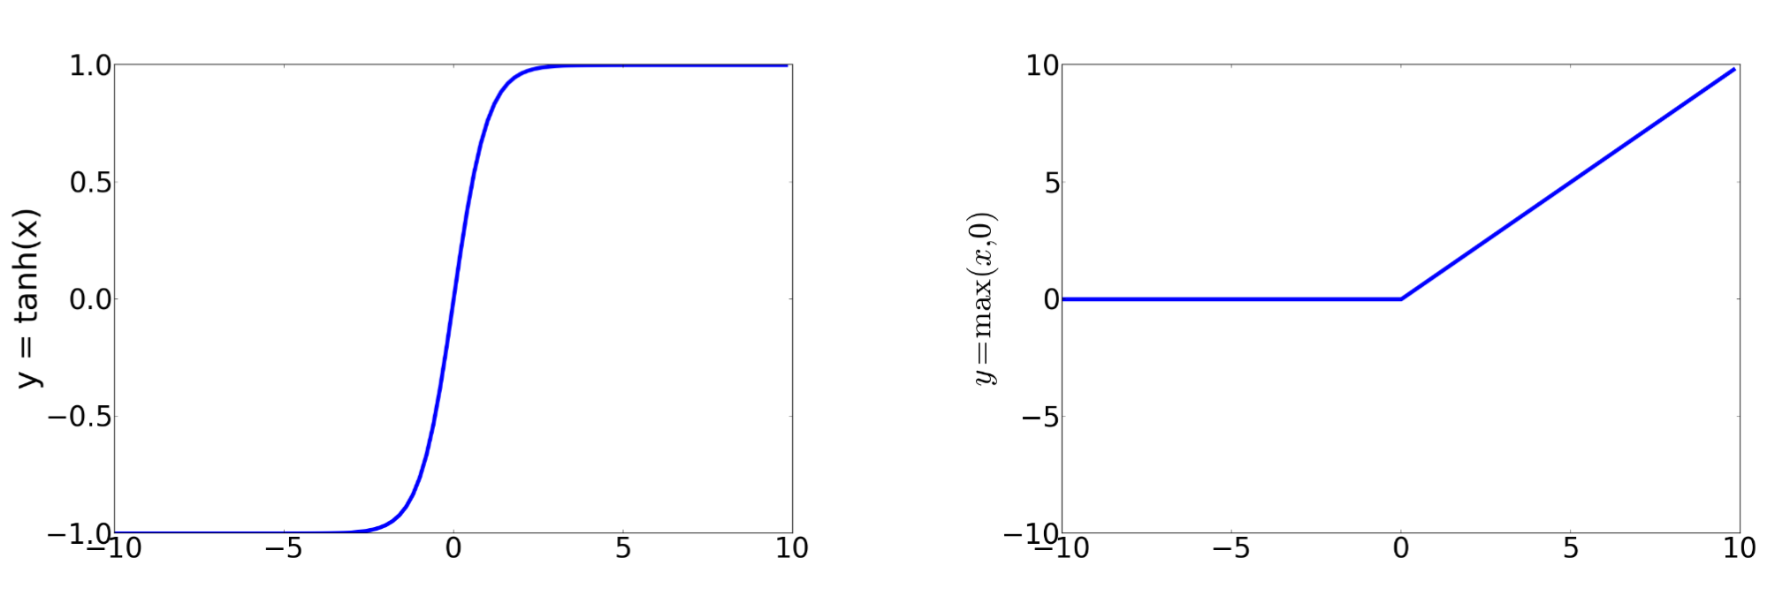
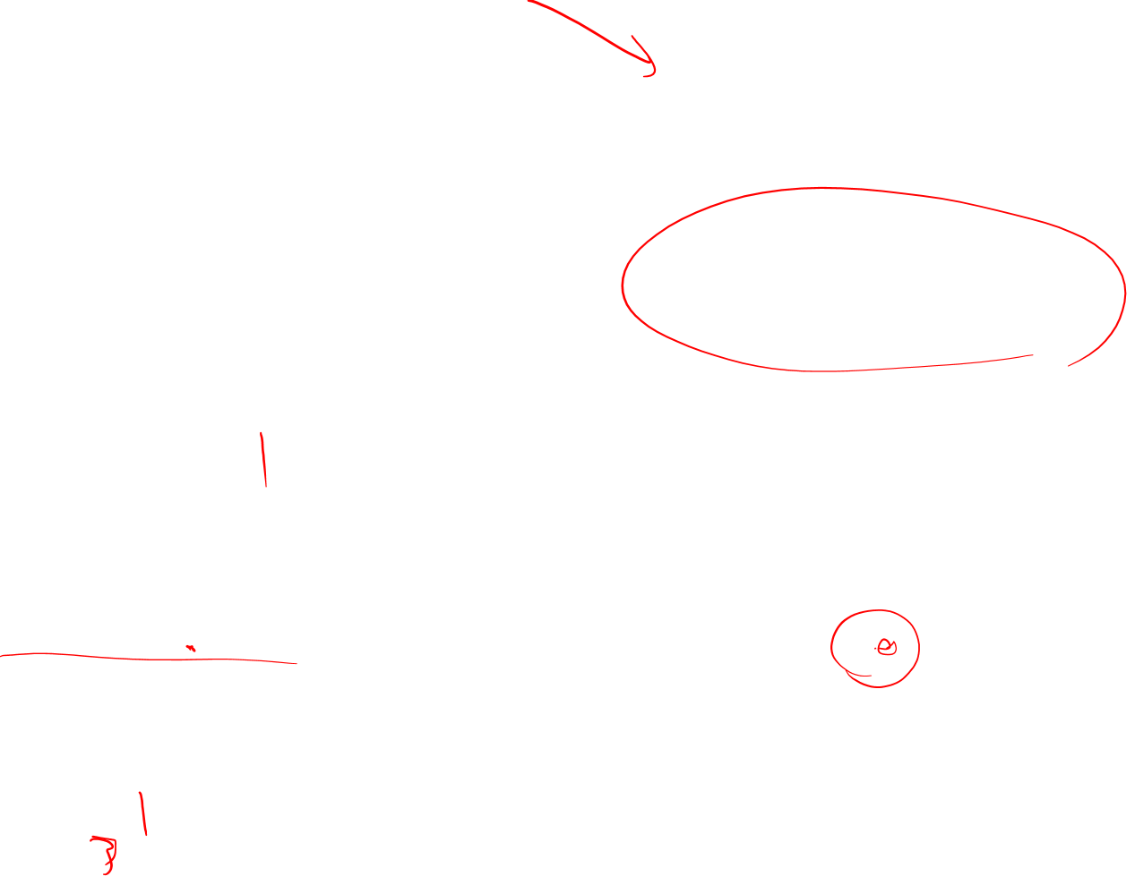
Tanh and ReLU
Between -1 and +1

Slide 8
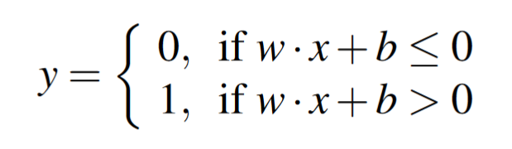
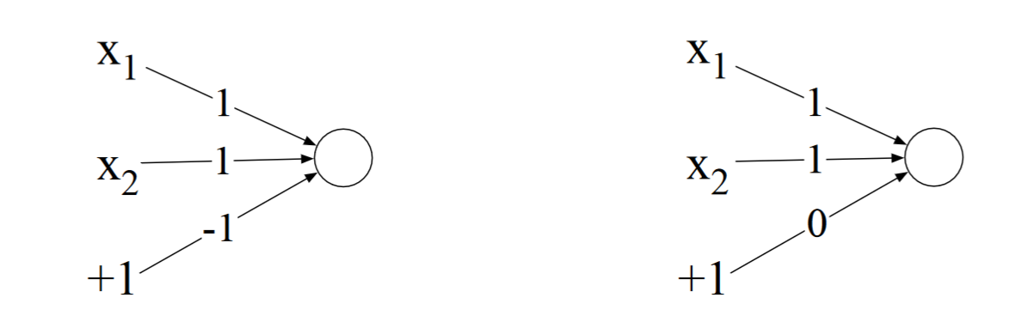
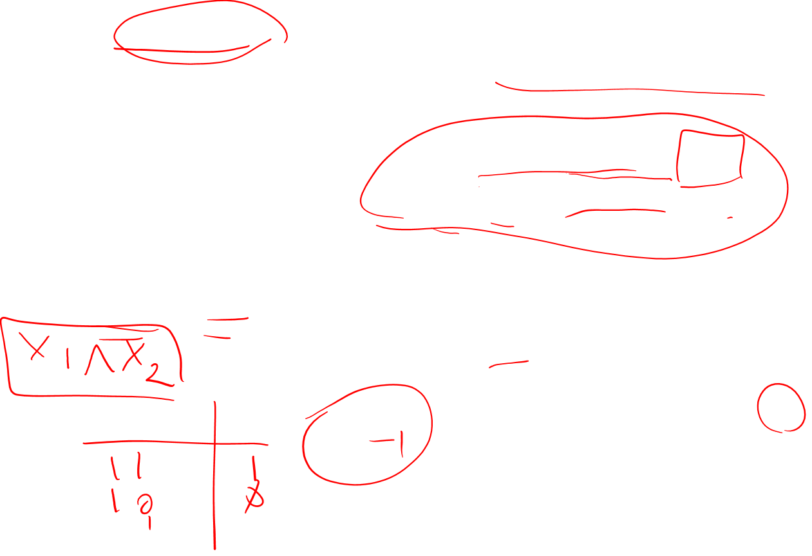
XOR problem
Perceptron: very simple neural perceptron unit that has a binary output and no non-linear activation function
AND - OR

Slide 9
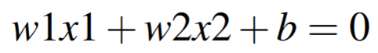
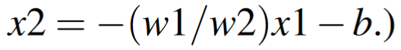
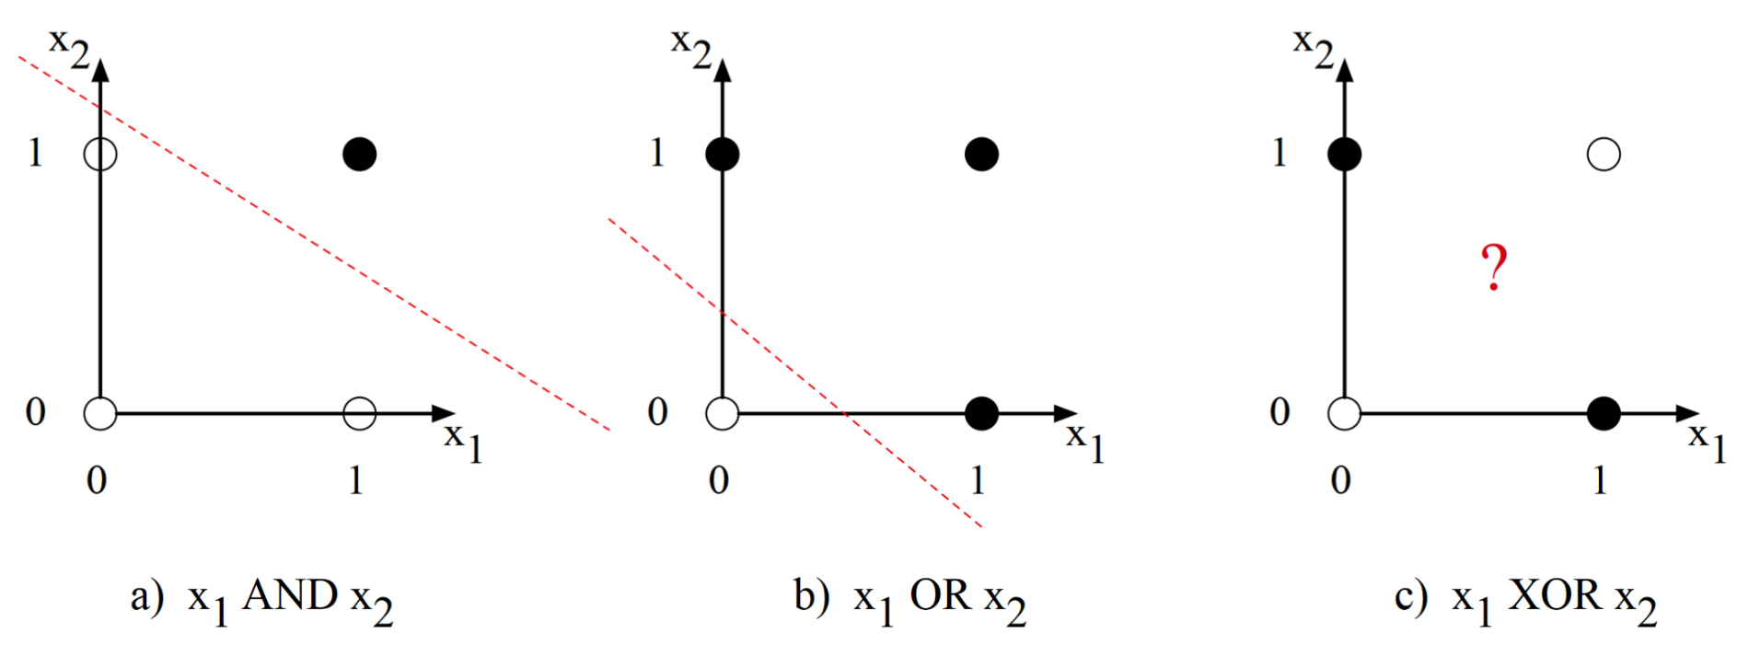
XOR?
Perceptron is linear

Slide 10
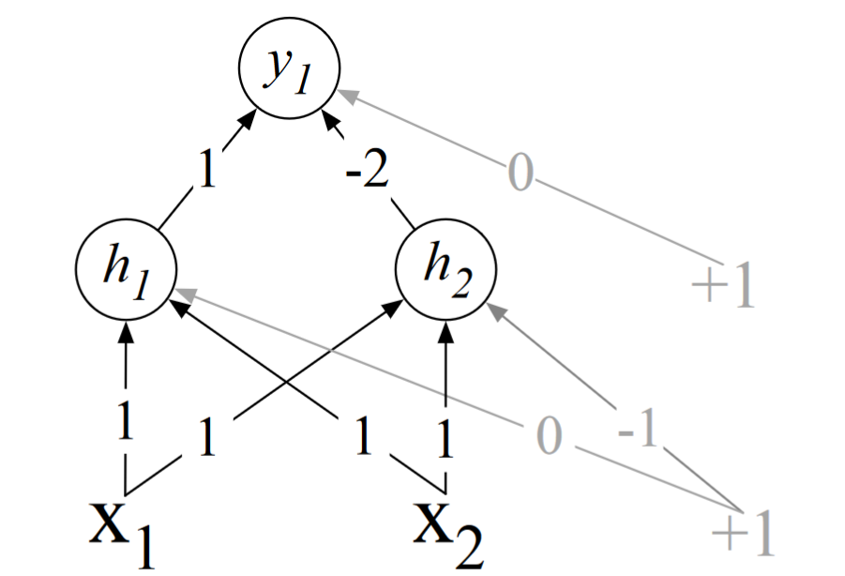
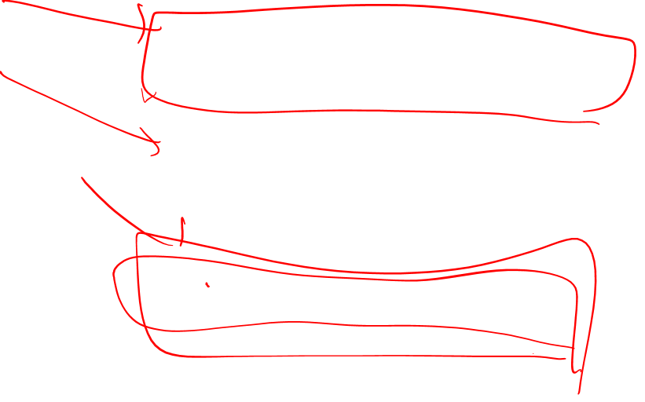
XOR: using two layers of ReLU-based units

Slide 11
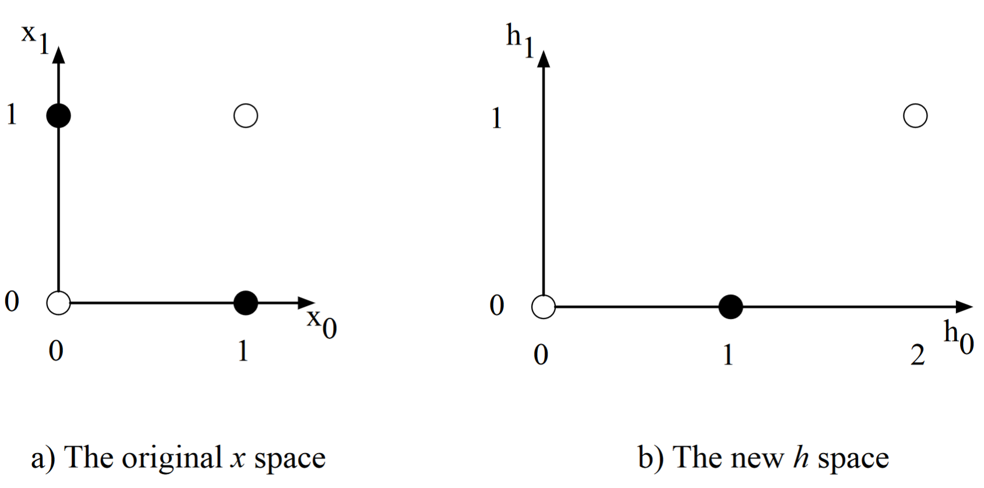
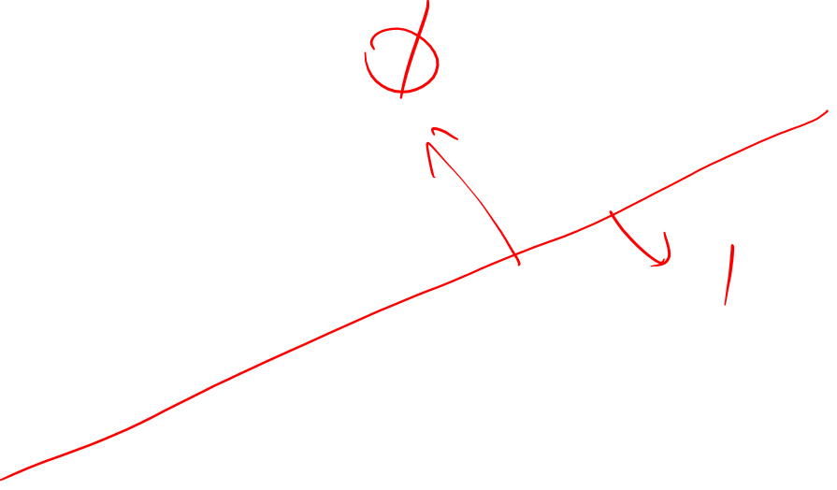
XOR problem

Slide 12
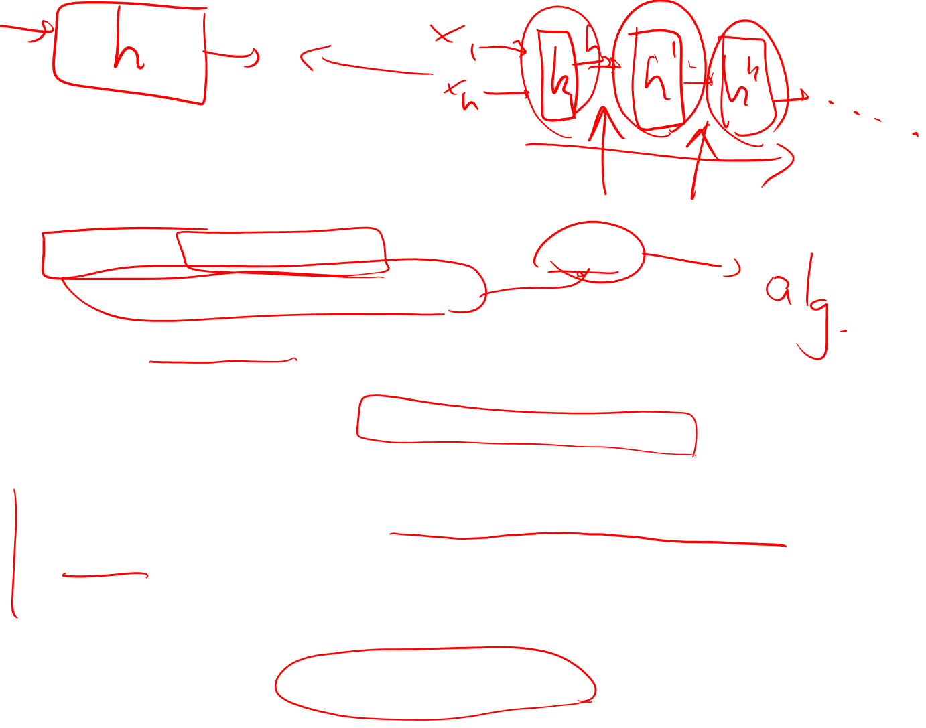
Neural Network
In real examples the weights for neural networks are learned automatically using the error backpropagation algorithm
the hidden layers will learn to form useful representations
automatically learn useful representations of the input, is one of their key advantages
a network formed by many layers of purely linear units can always be reduced (shown to be computationally identical to) a single layer of linear units with appropriate weights
The NEED for non-linear activation function

Slide 13
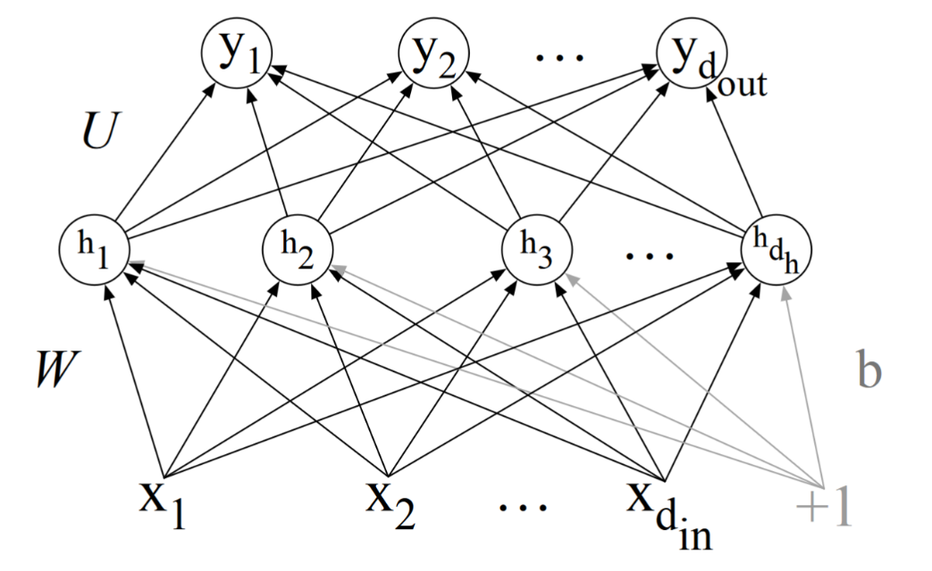
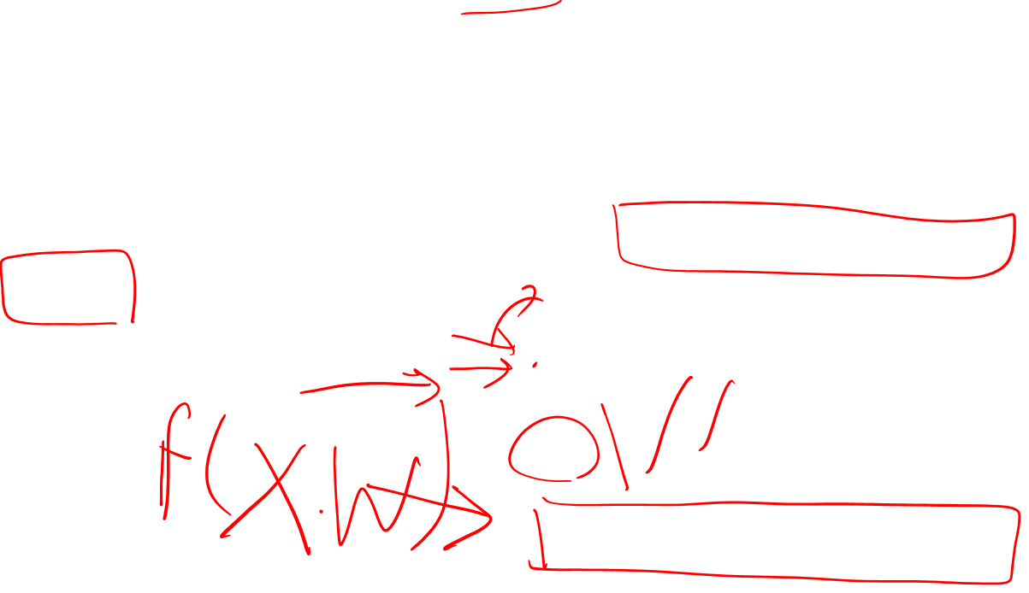
feed-forward network
Multilayer feed-forward network in which the units are connected with no cycles
outputs from units in each layer are passed to units in the next higher layer, and no outputs are passed back to lower layer
Recurrent neural networks: with cycle
multi-layer perceptron:
MLPs

Slide 14
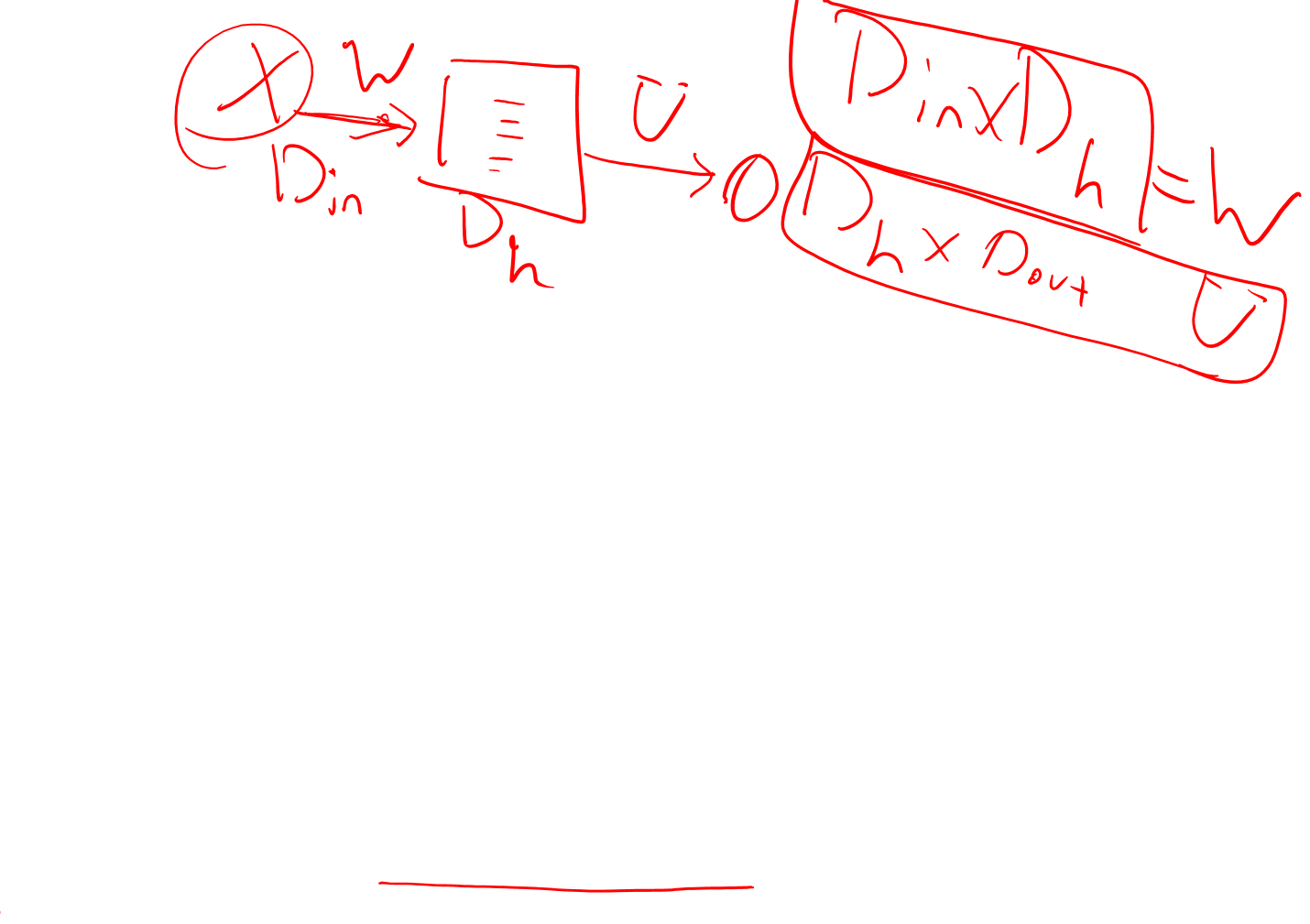
NN
Combining the weight wi and bias b for each unit into a single weight matrix W and b
simple matrix operations: multiplying the weight matrix by the input vector x , adding the bias vector B and applying the activation function f
D_{in}: dimension of input
D_{h}: dimension of hidden layer (and b also)
h is hidden and also hypothesis is a representation of X
Instead of hand-crafted feature set which are representation of input

Slide 15
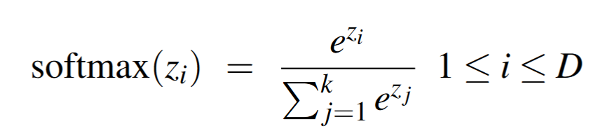
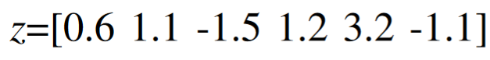
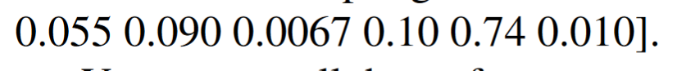
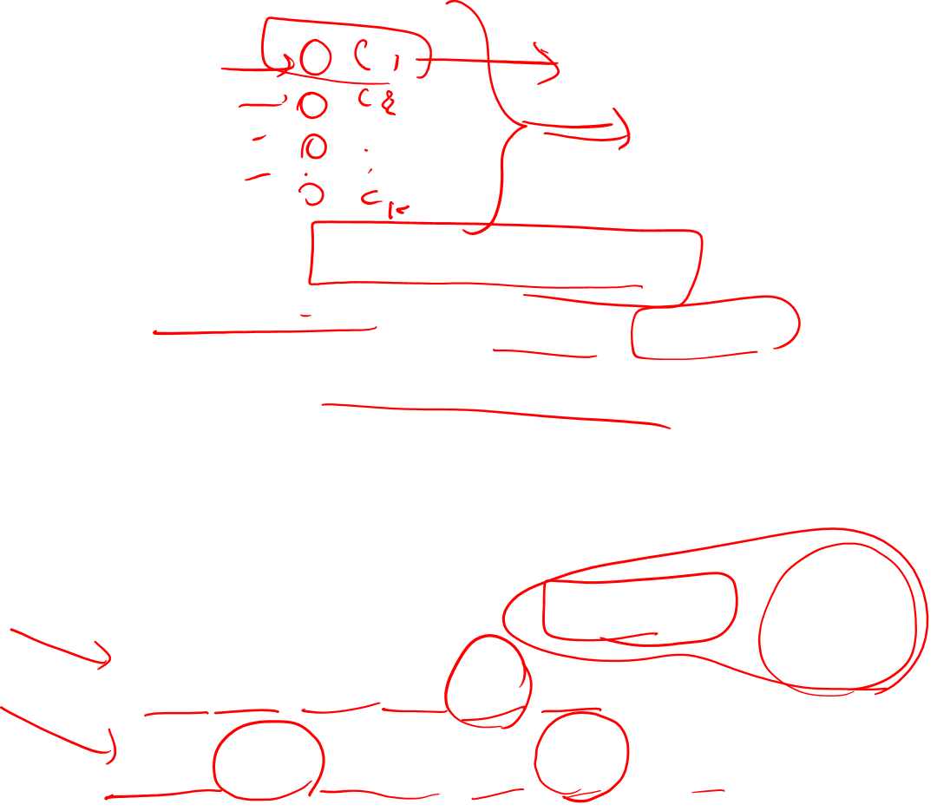
NN
Output could be classification task
For binary classification (sentiment) one node is enough
For multi-class, each class need a node
Z = Uh (no bias)
Need to be a vector of probability (sum to one)
Use softmax function for normalization
Softmax is the same for logistic regression

Slide 16
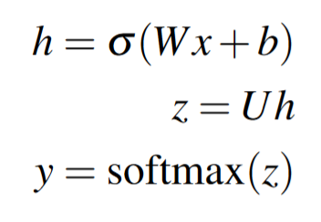

NN and logistic regression
neural network classifier with one hidden layer as building a vector h which is a hidden layer representation of the input, and then running standard logistic regression on the features that the network develops in h
the features were mainly designed by hand via feature template
NN is like logistic regression, but
with many layers,
rather than forming the features by feature templates, the prior layers of the network induce the feature representations themselves

Slide 17
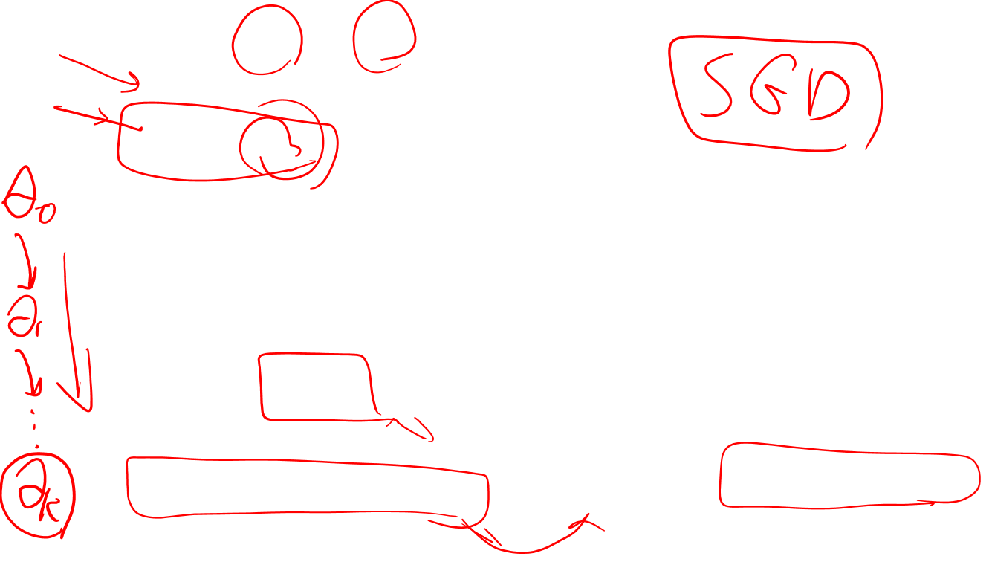
Training Neural Nets
Train Wi and bi for any layer i
Stochastic gradient descent
Θ = (W,b)
The intuition of gradient descent is to start with some initial guess at θ and then nudge the weights (i.e change θ slightly) in a direction that improves our system.
need a metric for whether the system has improved or not?
Supervised Learning: we know the correct answer

Slide 18
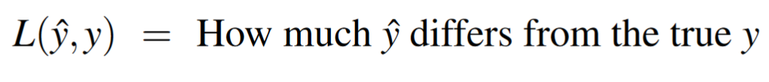
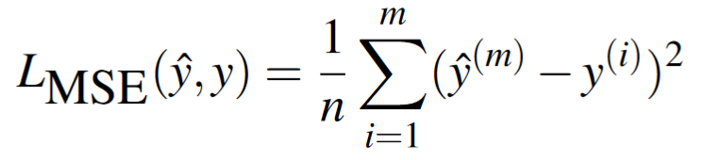
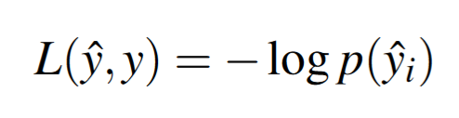
Loss or cost function
Loss function: distance between the system output and gold output
Example: out real output
How we measure the distance?
MSE: mean square error
For classification tasks: negative log likelihood or cross entropy
In one-hot vector:

Slide 19
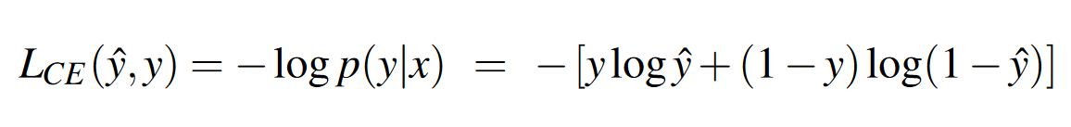
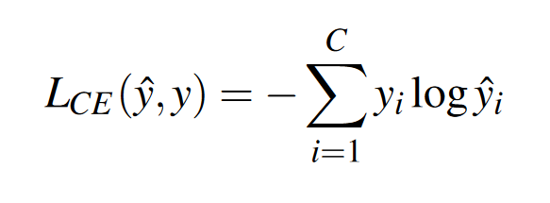
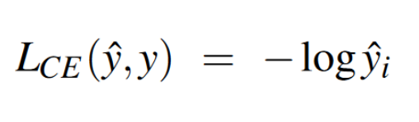
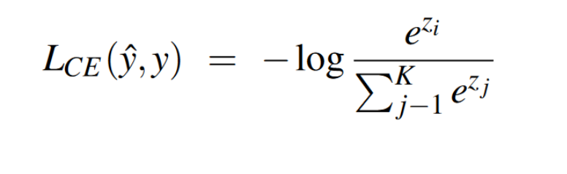

Loss function
For binary classification:
For multinomial classification:
hard classification task:
If the true class is i, then y is a vector where yi=1 and yj = 0 ∀j<>i.
For K class

Slide 20
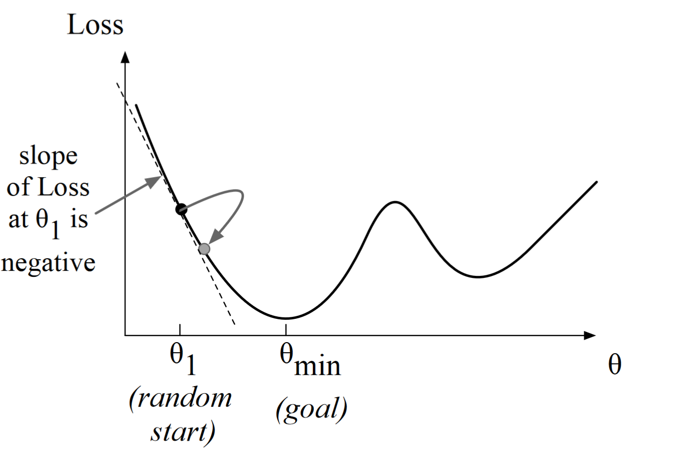
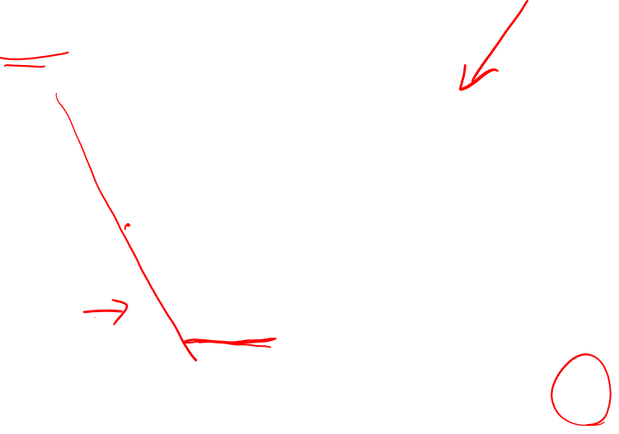
Following Gradients
finds a minimum of a function by figuring out in which direction (in the space of the parameters θ) the function’s slope is rising the most steeply, and moving in the opposite direction

Slide 21
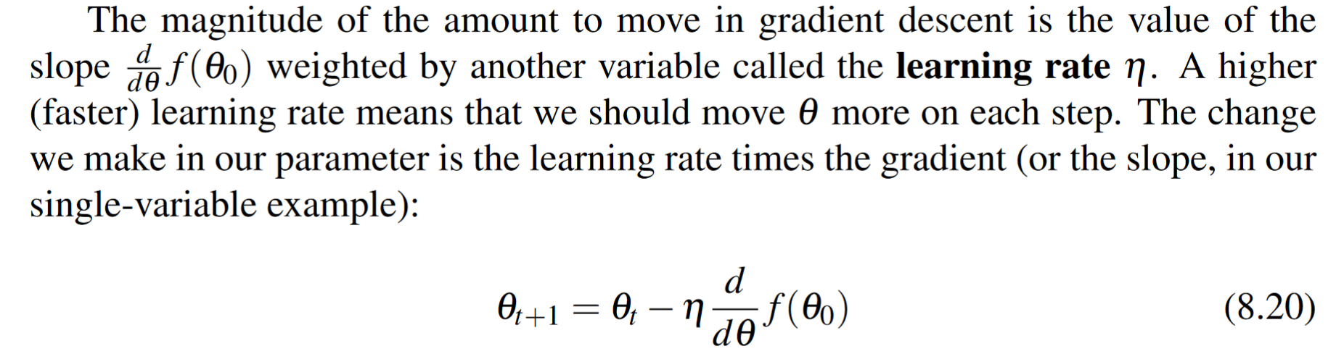
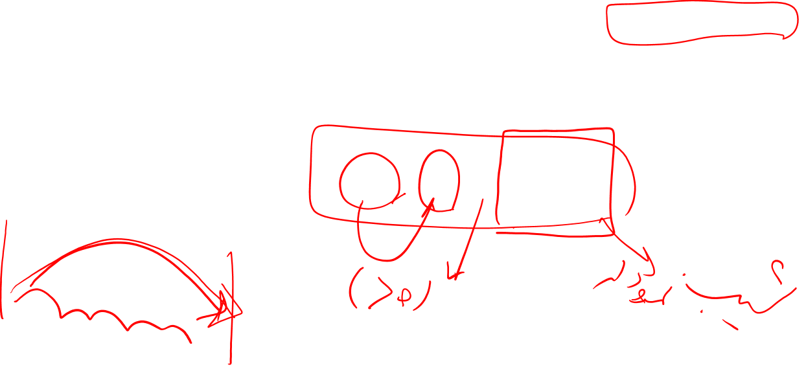
Training, one variable

Slide 22
Training , multi variable
If we are on a mesa and want to know which direction to walk down, we need a vector that tells us in which direction we should move.
The gradient is just such a vector; it expresses the directional components of the sharpest slope along each of those N dimensions

Slide 23


Training , multi variable

Slide 24



Training , multi variable
How much would a small change in that variable θj influence the loss function L ?

Slide 25



Computing the Gradient
For a network with one weight layer and sigmoid output (which is what logistic regression is):
for a network with one hidden layer and softmax output:
But these derivatives only give correct updates for one weight layer: the last one!

Slide 26

Computing the Gradient
requires the partial derivative of the loss function with respect to each parameter
complex for deep networks:loss is computed only at the very end of the network
error backpropagation
loss function modelled as a computation graph
node is a computation
edge the result of the computation

Slide 27



Computation Graphs
L(a,b,c) =c(a+2b).

Slide 28





Backward differentiation on computation graphs
our goal is to compute the derivative of the output function L with respect to each of the input variables:
chain rule: f(x) =u(v(x))

Slide 29






Slide 30



Slide 31






Slide 32

More details on learning
Optimization in neural networks is a non-convex optimization problem, more complex than for logistic regression,
need to initialize theweights with small random numbers: normalize the input valuesto have 0 mean and unit variance
regularization : dropout (randomly dropping some units and their connections from the dropout network during training)
Hyperparameter: learning rate η, the minibatch size, the model architecture (the number of layers, the number of hiddennodes per layer, the choice of activation functions), how to regularize.
parallelization onto vector-based GPUs: TensorFlow , Pytorch

Slide 33



Slide 34


Slide 35



Slide 36



Slide 37

stochastic because it chooses a single random example at a time
Minibatch gradient descent, computes the gradient over batches of minibatch training instances rather than a single instance
learning rate η_{k} is a parameter that must be adjuste

Slide 38

Neural Language Model
First application of NN is language modeling:
predicting upcoming words from prior word context
don’t need smoothing, they can handle much longer histories, and they can generalize over contexts of similar words.
slower to train than traditional language models
for many tasks traditional language modeling is still the right technology.
First attemps: Bengio et al. (2003)

Slide 39


Feedforward neural LM
Takes as input at time t a representation of some number of previous words (wt−1,wt−2, etc) and outputs a probability distribution over possible next words

Slide 40

Embeddings
Each word is represented as a vector of real numbers of of dimension d
d tends to lie between 50 and 500
This vectors is called embeddings
In many traditional NLP applications, a word is represented as a string of letters, or an index in a vocabulary list(one-hot)
distributed representation allows words that have similar meanings, or similar grammatical properties, to have similar vectors
words like “cat” and “dog”— words with similar meaning and parts of speech—will be similar vectors

Slide 41

embedding
“I have to make sure when I get home to feed the cat.”
suppose we’ve never seen the word “dog” after the words ”feed the”
In our test set we are trying to predict what comes after the prefix “I forgot when I got home to feed the” ???
Ngram predict cat but no dog
By Embedding it could predict dog too
…

Slide 42


FFNNLM

Slide 43

Embedding
assuming we learn the embeddings separately by a method like the word2vec
Pretraining: using another algorithm to learn the embedding representations
Or
often we’d like to learn the embeddings simultaneously with training the network (task- specific embedding)
This is true when whatever task the network is designed for (sentiment classification, or translation, or parsing) places strong constraints on what makes a good representation
To do this add an extra layer to the network

Slide 44


One-hot vector
Used when we don’t use pretraining and train task-specific embedding
Word = toothpaste

Slide 45



Slide 46


FFNNLM
1. Select three embeddings from E
2. Multiply by W
3. Multiply by U
4. Apply softmax

Slide 47

Training
θ=E,W,U,b
SGD algorithm with error back propagation to compute the gradien
Training not only sets the weight W and U of the network, but also as we’re predicting upcoming words, we’re learning the embeddings E for each words that best predict upcoming words

